Slide 1
Firefly 2 – Project Meeting #04
Mobiles und vernetztes Positionierungssystem zur gestützten Navigation in urbanen Umgebungen

Slide 2
Overview
Preprocessing/Correction
GNSS + PL
SPP
ML
SPP
LC EKF
IMU

Slide 3
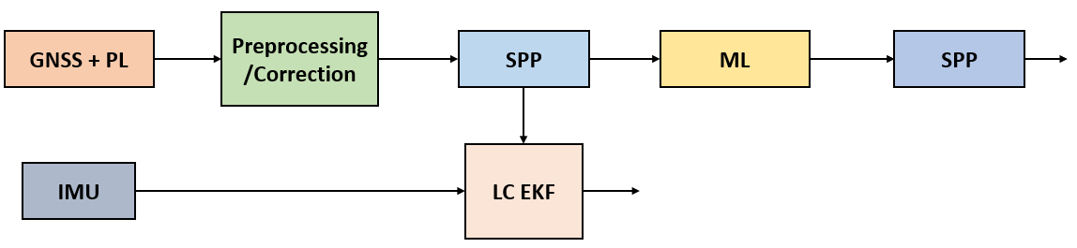
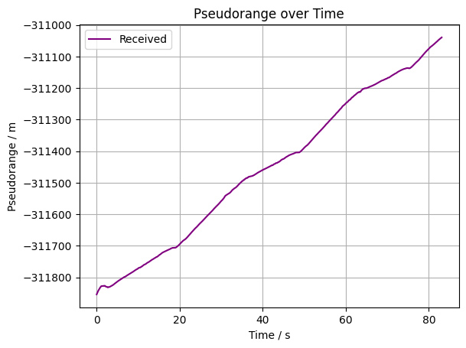
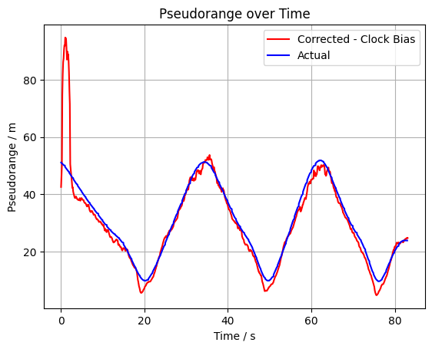
Real-World Data Preprocessing
Handover from Qiaoxiao (End of June)
Familiarize and fix some bugs
Switch to Python (Flexible and better for development)

Slide 4
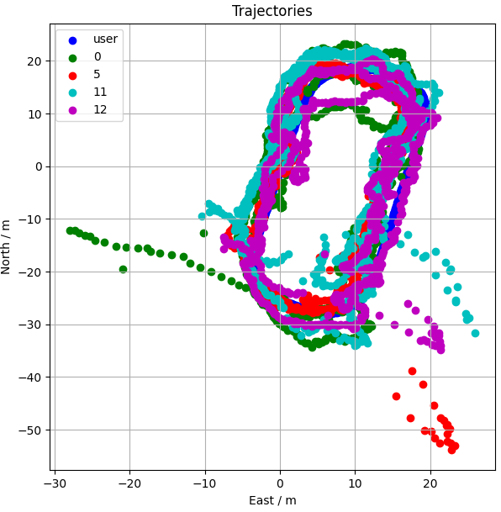
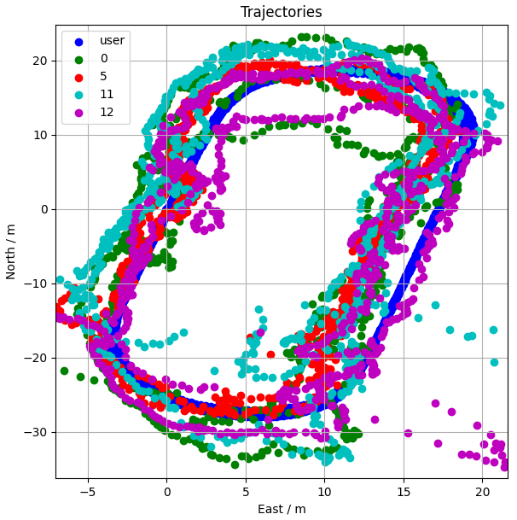
Real-World Data LS
SPP/Least Squares
GT
GPS
All
GPS+PL
GPS+LTE
GT
GPS
All
GPS+PL
GPS+LTE

Slide 5
Real-World Data LS
SPP/Least Squares
GT
GPS
All
GPS+PL
GPS+LTE
Case | 2D Error / m | 3D Error / m
GPS | 5.299 | 13.940
All | 2.880 | 3.641
GPS+PL | 4.842 | 6.520
GPS+LTE | 2.900 | 4.278

Slide 6
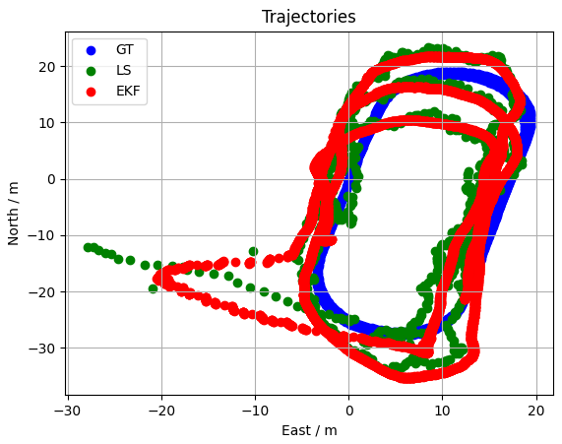
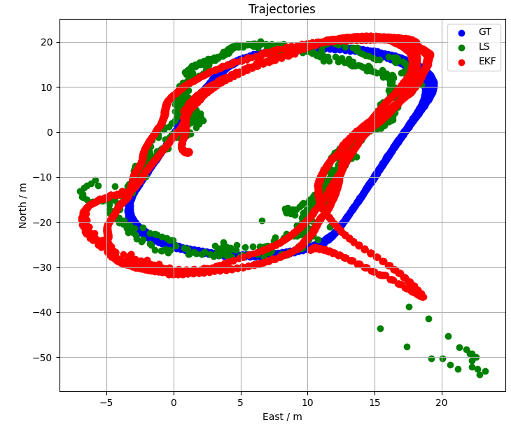
Real-World Data EKF
LC EKF
  GPS only (Left), All (Right)
Still need tuning

Slide 7
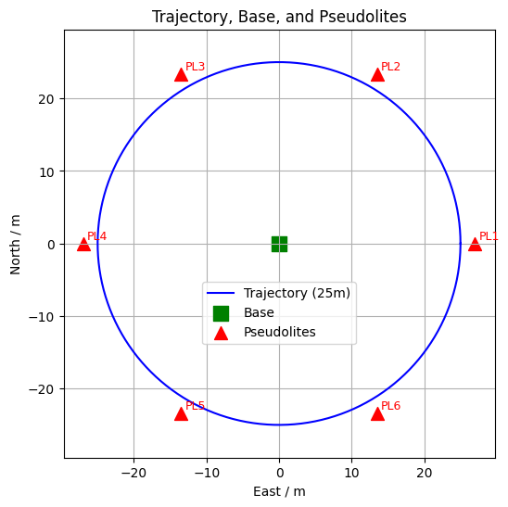
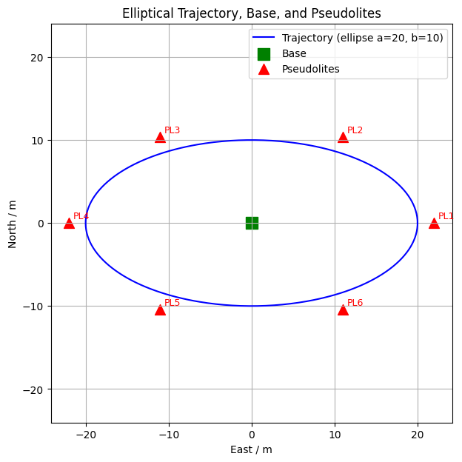
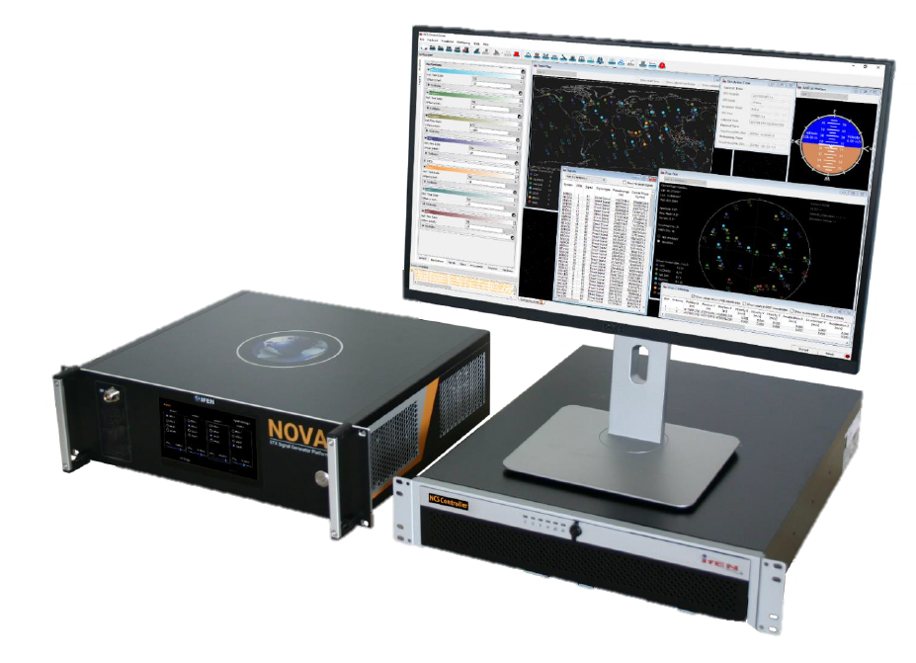
Simulation Data
Simulation data for ML
  Similar location/time with MC
  Circle (r=15, 25)
  Ellipse (a=14, b=8; a=20, b=10)
NCS NOVA GNSS Simulator [1]
[1] IFEN NCS NOVA GNSS Simulator manual, https://www.ifen.com/fileadmin/documents/pdf/NCS_TITAN_und_NOVA/STX.NOVA_July2019.pdf

Slide 8
Simulation Data
Multipath simulation
Imbalanced LOS and NLOS data
Open-sourced data: 50~80% LOS
  HK: 60% LOS
  Aachen: 80% LOS
Environment | System | Circle LOS % | Ellipse LOS %
Urban | GPS | ~18% | ~20%
 | PL | ~82% | ~93%
Suburban | GPS | ~30% | ~22%
 | PL | 75–83% | ~93%

Slide 9
Simulation Data
Difference between simulated and real-world data
Commonly used features for ML
Feature | System | RW Mean | Sim Mean | Diff
Doppler shift | GPS | -191.29 | -27.49 | -163.80
 | PL | 52.19 | -0.00 | 52.19
Elevation | GPS | 43.26 | 35.34 | 7.92
 | PL | 4.47 | 16.13 | -11.66
Pseudorange Residual | GPS | -0.37 | -0.29 | -0.08
 | PL | 1.28 | -0.34 | 1.62
Pseudorange | GPS | 22,186,348.15 | 22,612,315.60 | -425,967.45
 | PL | 26.72 | 20.71 | 6.02
CN0 | GPS | 43.61 | 35.94 | 7.68
 | PL | 47.73 | 169.10 | -121.37
Vehicle speed
Different Sat
Unrealistic model
Unable to change simulated signal power

Slide 10
Simulation Data
Features: CN0, elevation, pseudorange residual
SVM (Support Vector Machine)
  Non-temporal
  Linear or non-linear decision boundary
Imbalanced and balanced data
Dataset | Sim Testing Accuracy | Real-world GPS LOS | Real-world PL LOS
Imbalanced | 78% | 0.1% | 100%
Balanced | 78% | 65% | 80%

Slide 11
Simulation Data
Features: CN0, elevation, pseudorange residual
LSTM (Long Short-Term Memory)
  Temporal
  Does not make sense to make imbalanced data balanced
Sim Testing Accuracy | Real-world GPS LOS | Real-world PL LOS
89% | 5.7% | 21.9%

Slide 12
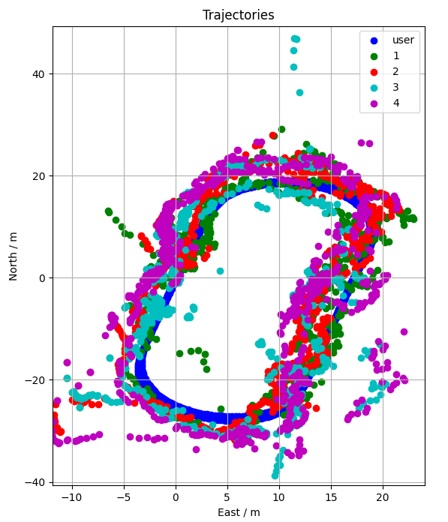
Exclude Classified Data in Positioning
SVM Balanced
Dataset | Sim Testing Accuracy | Real-world GPS LOS | Real-world PL LOS
Imbalanced | 78% | 0.1% | 100%
Balanced | 78% | 65% | 80%
Case | Avail. Pos | 2D Error / m | 3D Error / m
1: GPS | 697 | 3.26 | 5.07
2: GPS+PL | 697 | 3.31 | 3.97
3: GPS+ML | 543 | 8.57 | 11.87
4: GPS+PL+ML | 690 | 5.10 | 6.39

